Slide 1

Water Potability Predictor and Chatbot
Team Members :
Arshad Shaik
Diviz Kondamadugula
Gouri Sirisha Kokkirala

Slide 2
Project Concept
One-Sentence Solution:
Our technology solution is a Flask-based web application that predicts water potability using a trained ANN model, enables interactive AI-driven Q&A about water quality.
Target Audience / Stakeholders:
Researchers and environmental scientists to predict and analyze water potability trends.
Water quality analysts and policymakers to make data-driven decisions for purification and public health.
General public and students to easily check water safety and learn about water quality standards.
Development Tools:
Python (Flask Framework).
TensorFlow and Scikit-learn for model development.
OpenAI API via OpenRouter for AI chat.
Pandas and Matplotlib for data handling.
HTML, Tailwind CSS, and JavaScript for frontend.
Tableau Public for dashboard visualization.
Dataset: water-potability - with 13 attributes like pH, Solids, Hardness etc.

Slide 3
Requirements
Predict water potability based on input chemical parameters
Enable AI-based Q&A support focused on water quality
Tableau dashboard for deeper data insights
Create a user-friendly and visually appealing web application

Slide 4
Accomplishments
Successfully built and deployed the Flask web application.
Integrated ANN model prediction with feature scaling.
Connected Mistral 7b LLM to chatbot for water-related queries.
Tableau dashboard for advanced visual analysis.
Functionality :
The backend Flask server handles three main APIs: prediction, AI chat
The ANN model predicts water potability using scaled user inputs for 9 chemical features.
API (via OpenRouter : Mistral 7b) powers a chatbot restricted to water potability knowledge.
The frontend uses HTML, Tailwind CSS, and JavaScript to interact with Flask APIs and render responses.
A live Tableau dashboard for advanced data exploration.

Slide 5
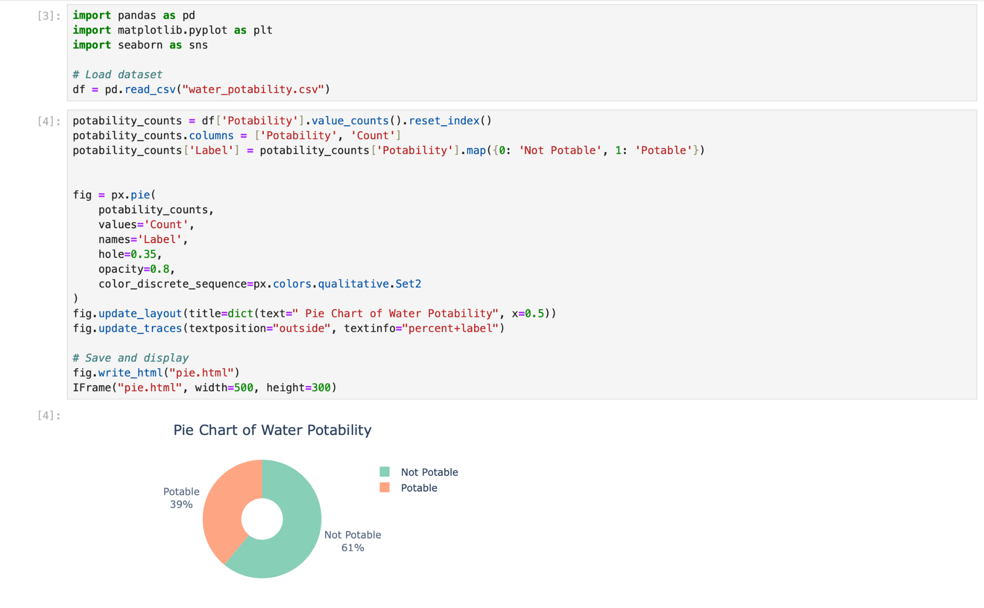
Data Set

Slide 6
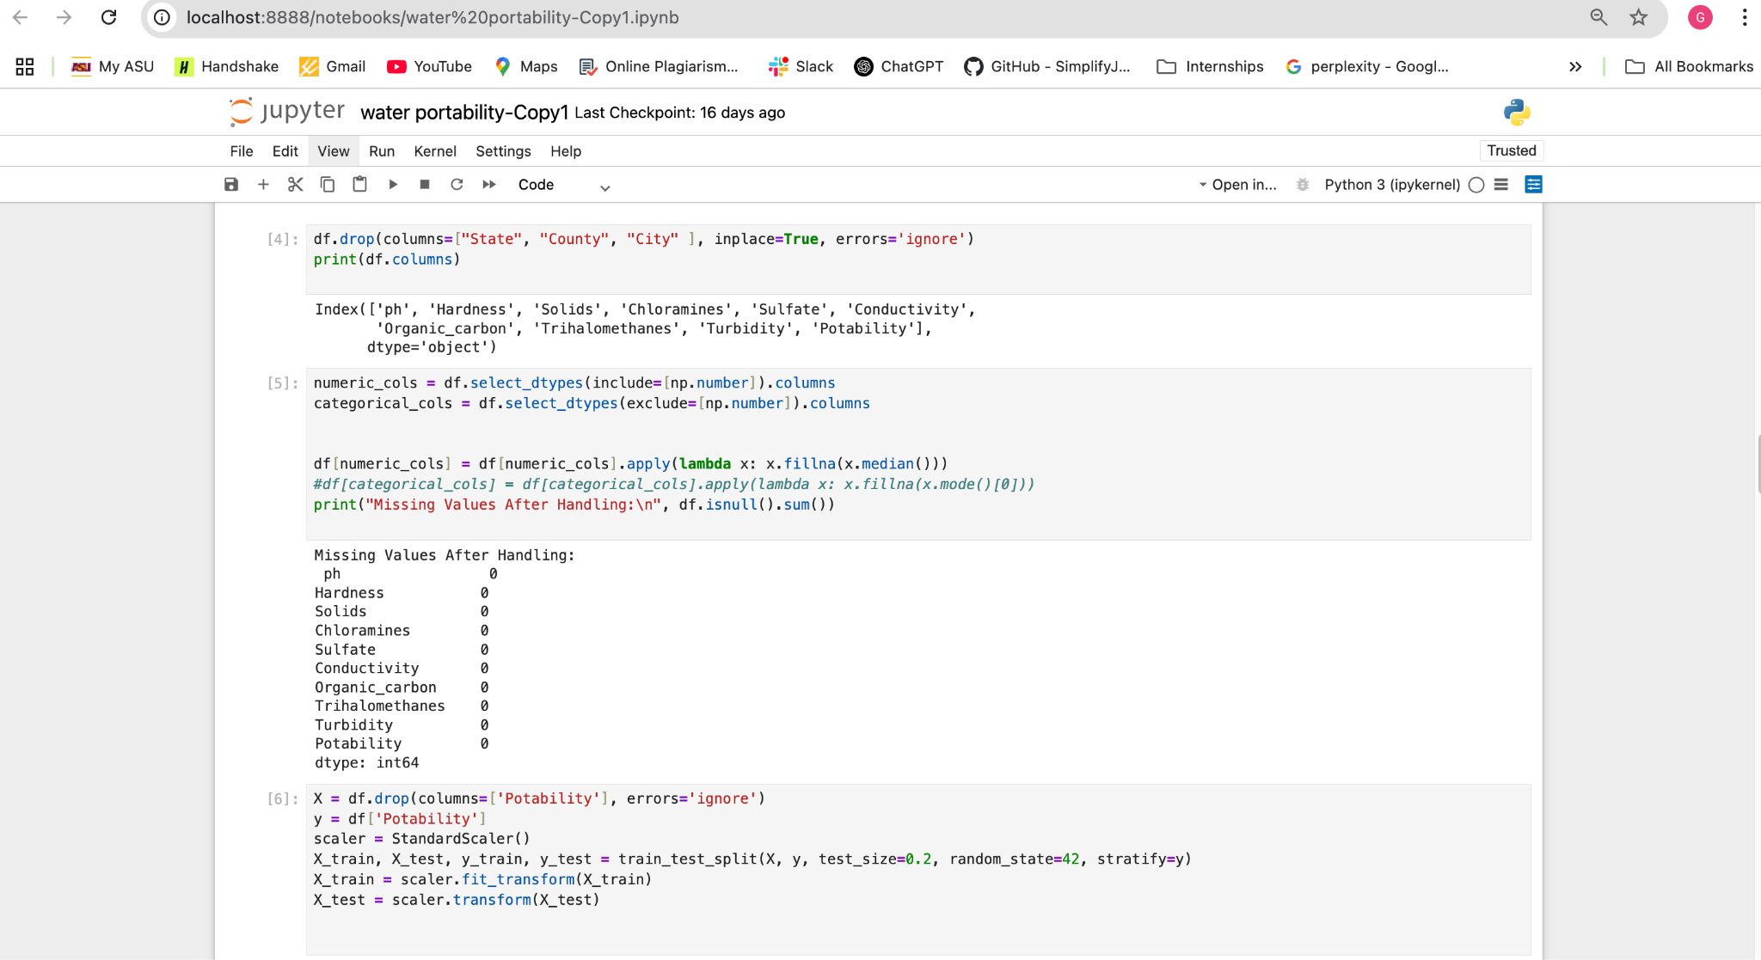
Data Preprocessing

Slide 7
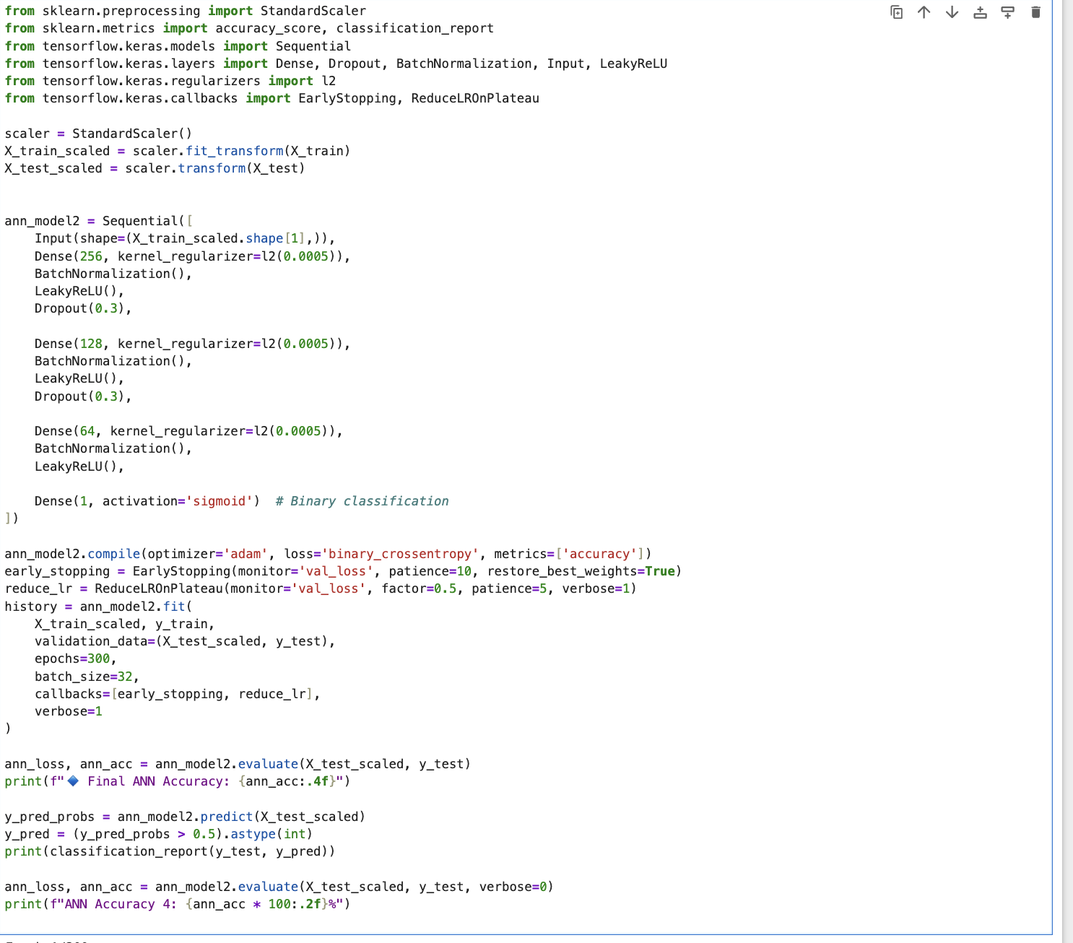
Implementation of ANN

Slide 8
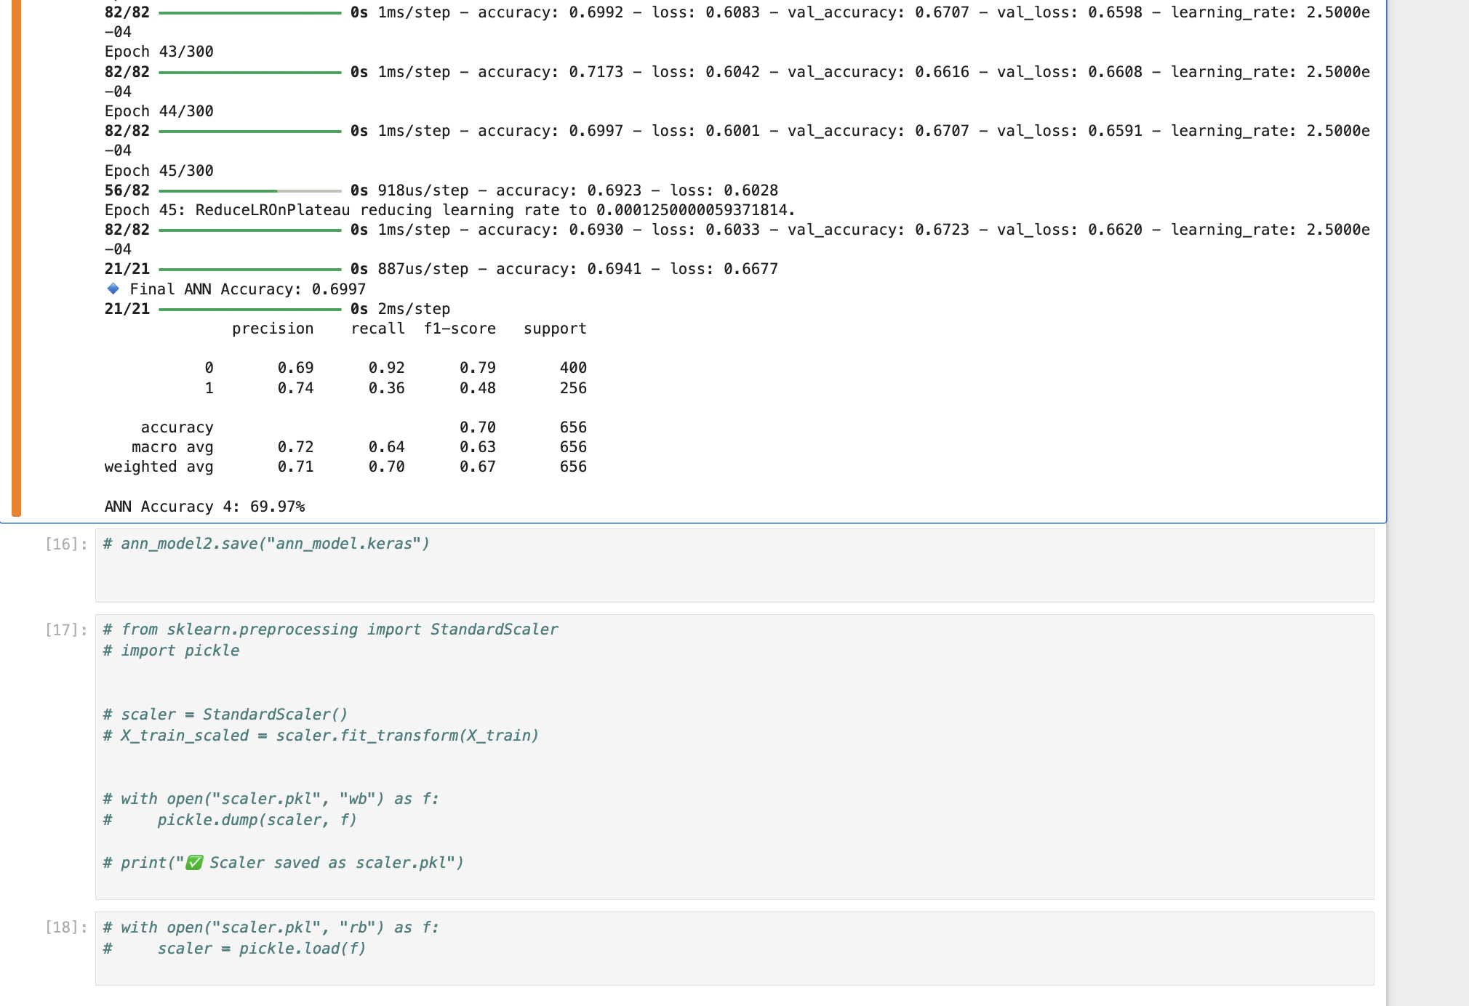
ANN Accuracy and Model Building

Slide 9
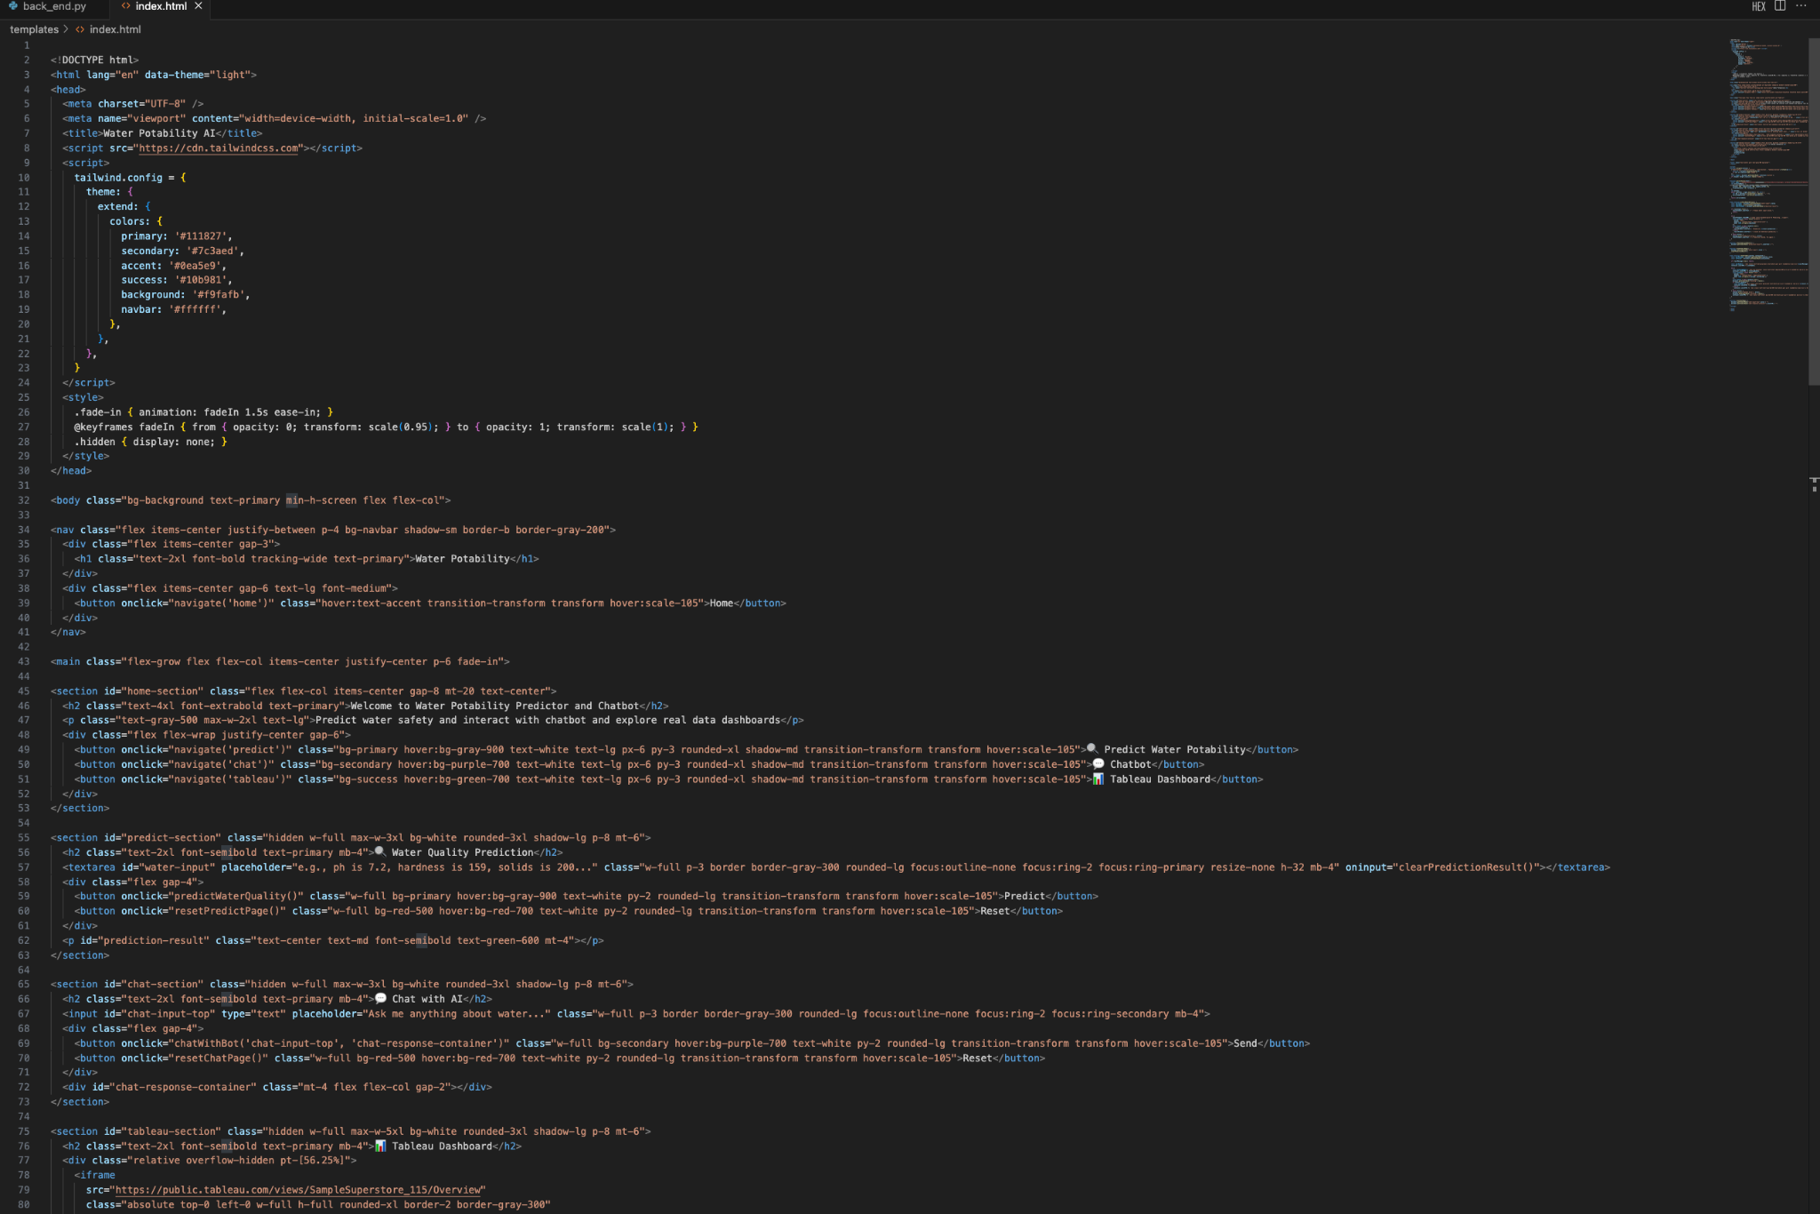
Implementation of UI

Slide 10
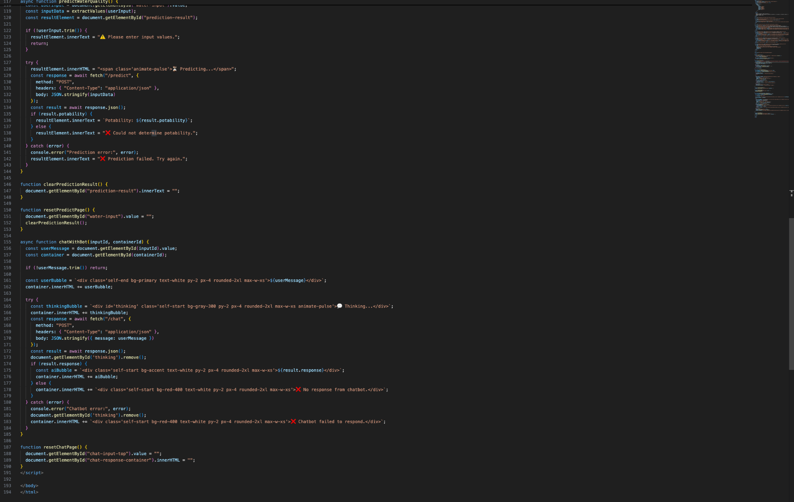
Implementation of UI

Slide 11
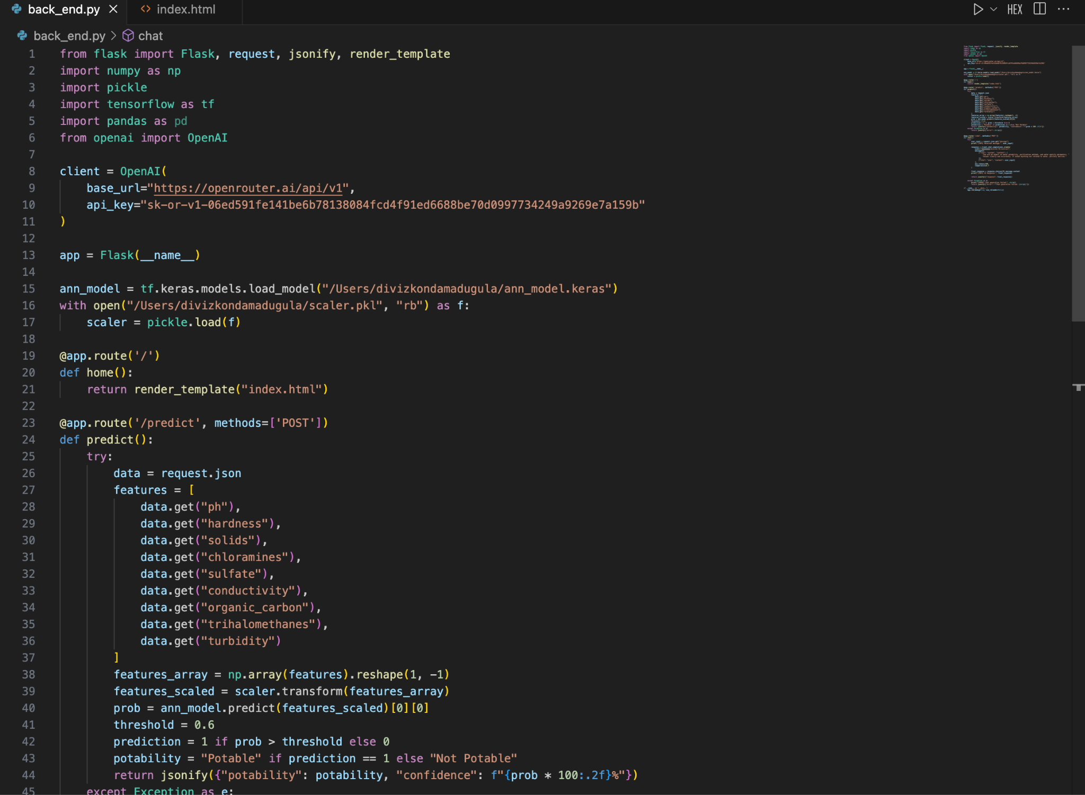
Implementation of Backend

Slide 12
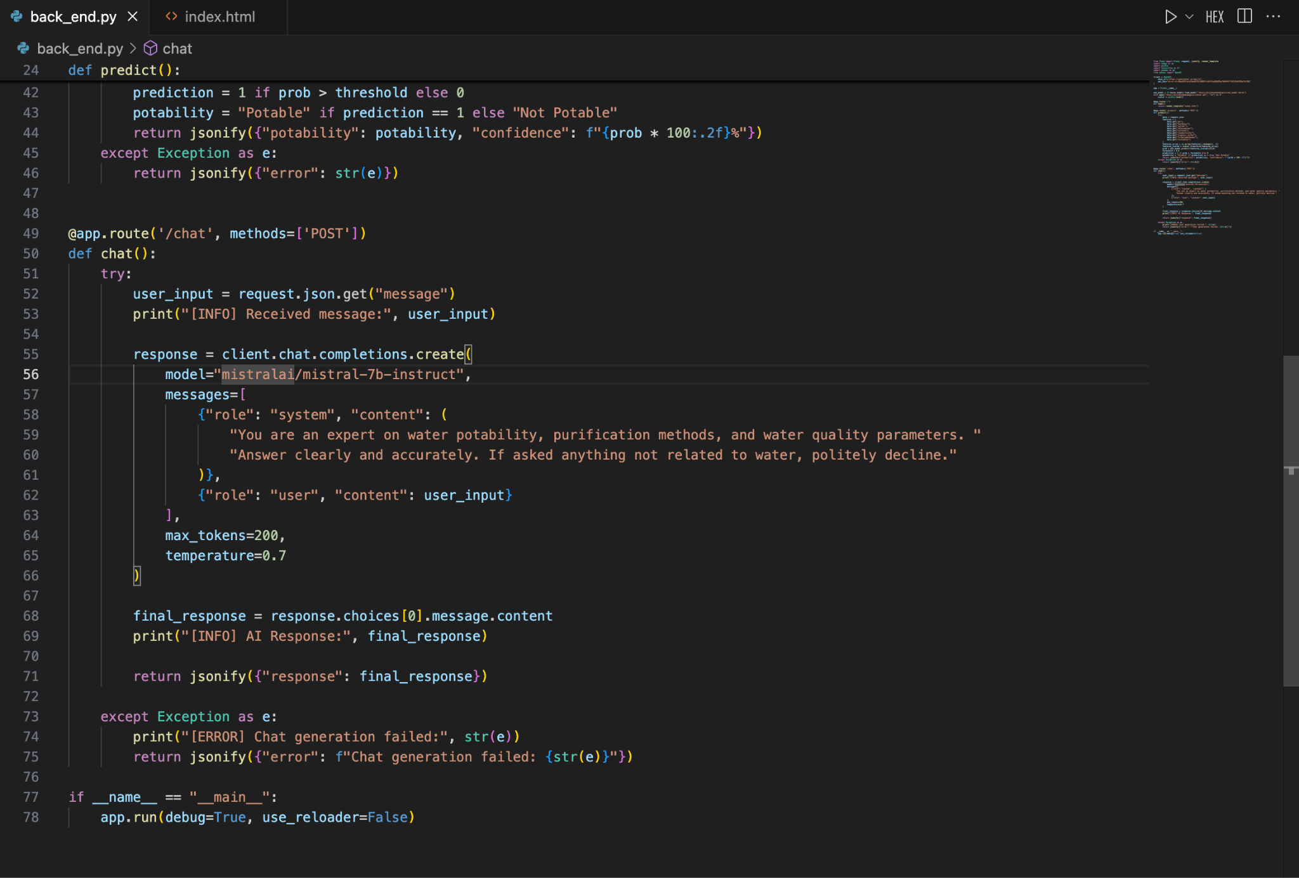
Implementation of Backend

Slide 13
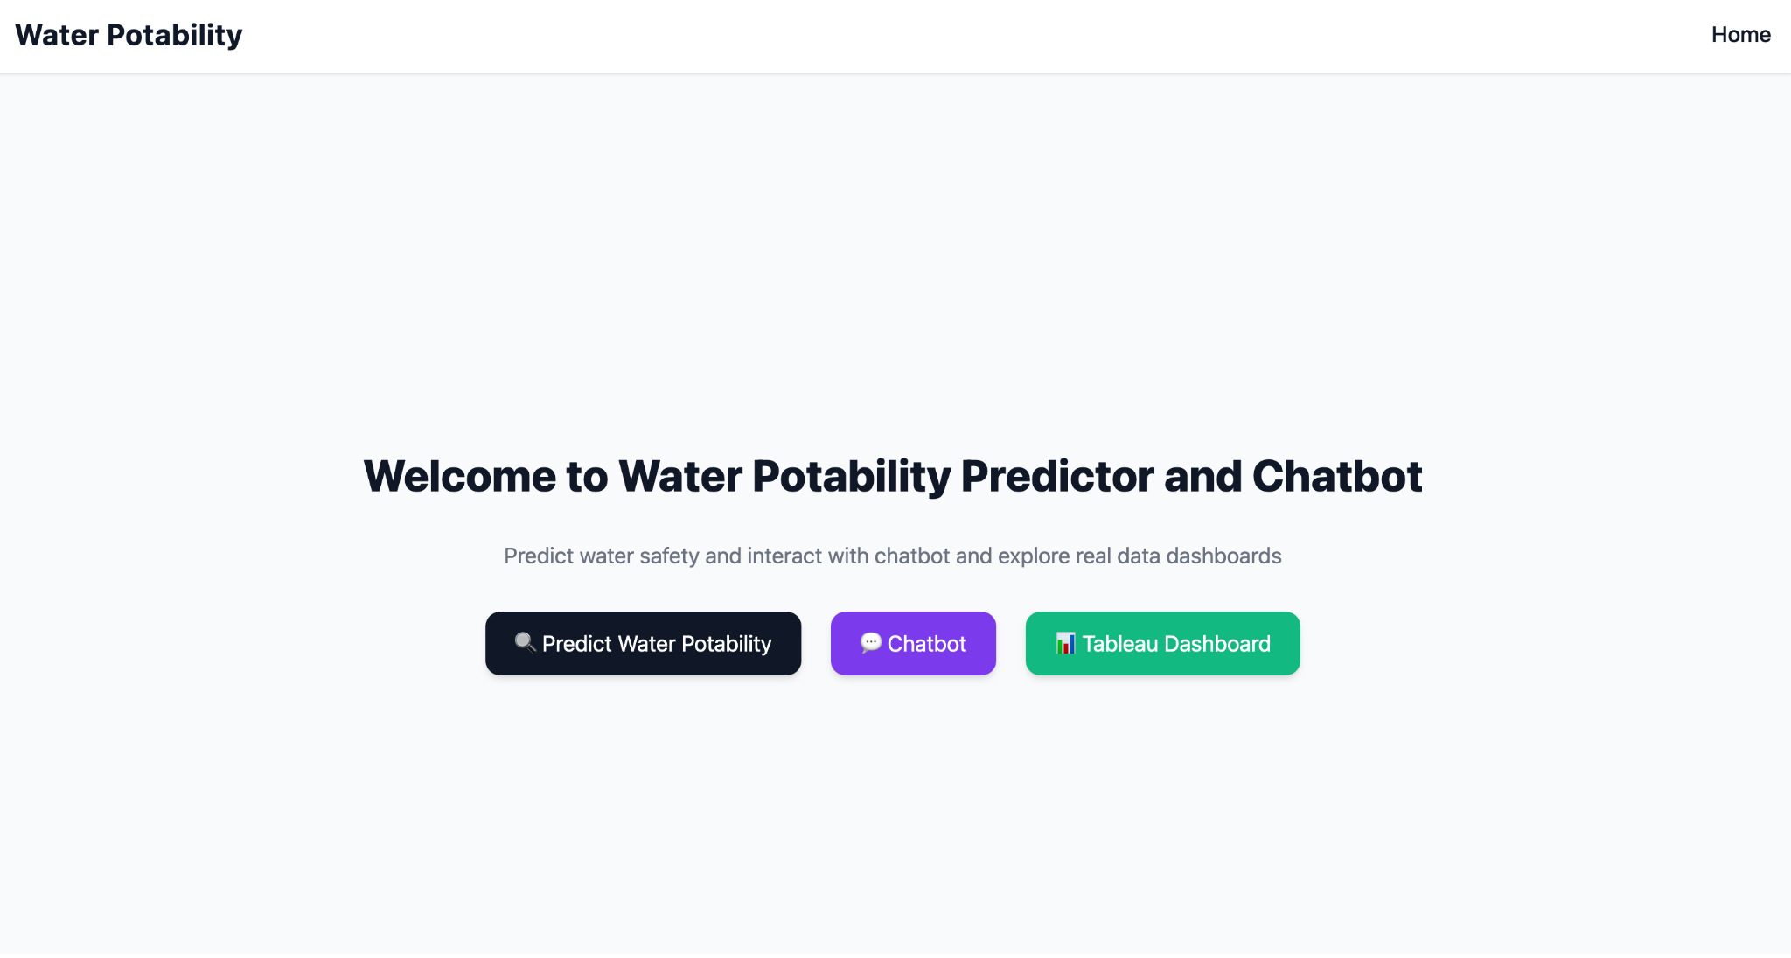
Results
Homepage :

Slide 14
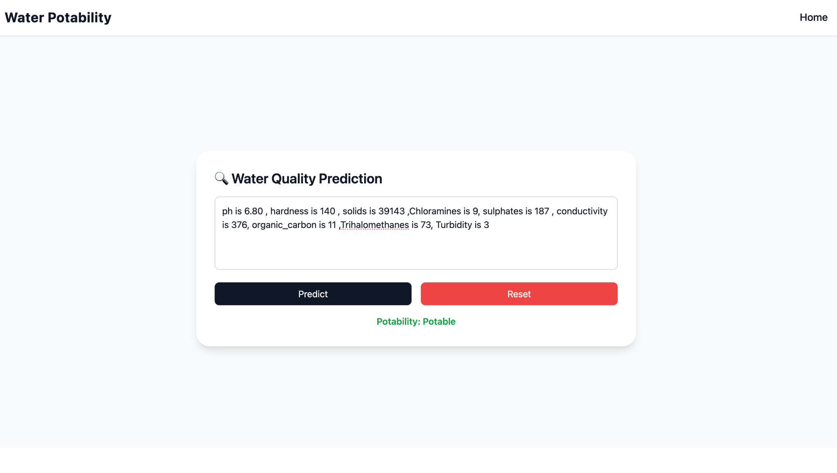
This is an example for the system predicting water is Potable.

Slide 15

This is an example for the system predicting water is Not Potable.

Slide 16
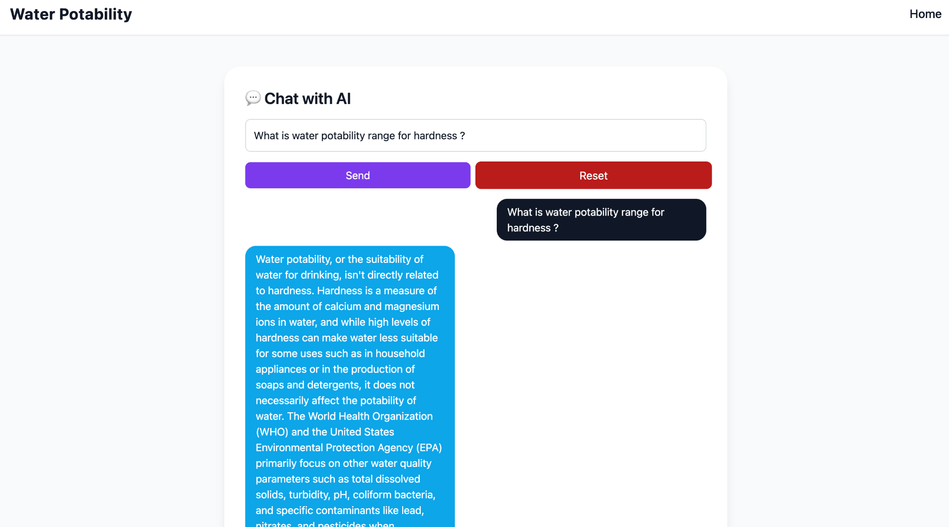
Chatbot Functionality

Slide 17
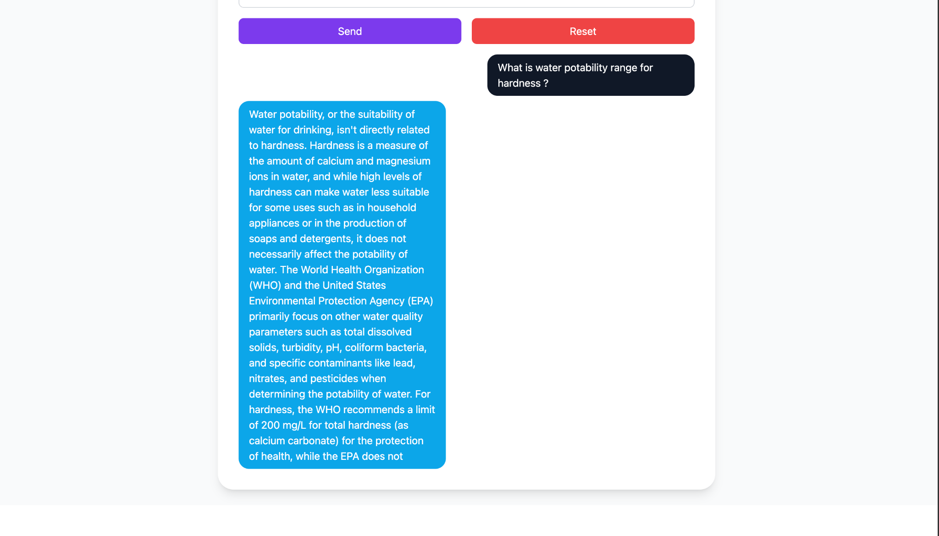

Slide 18
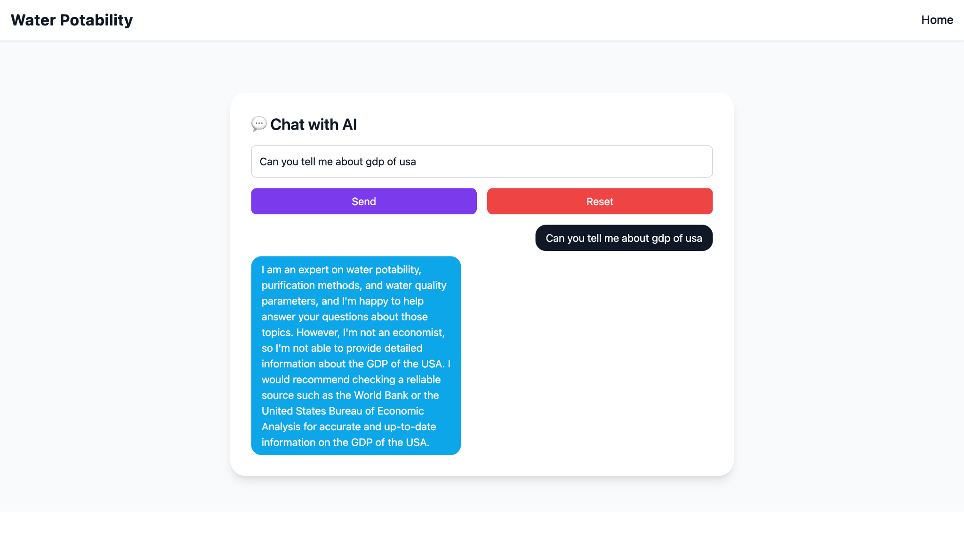
Response given by chatbot for Irrelevant question

Slide 19
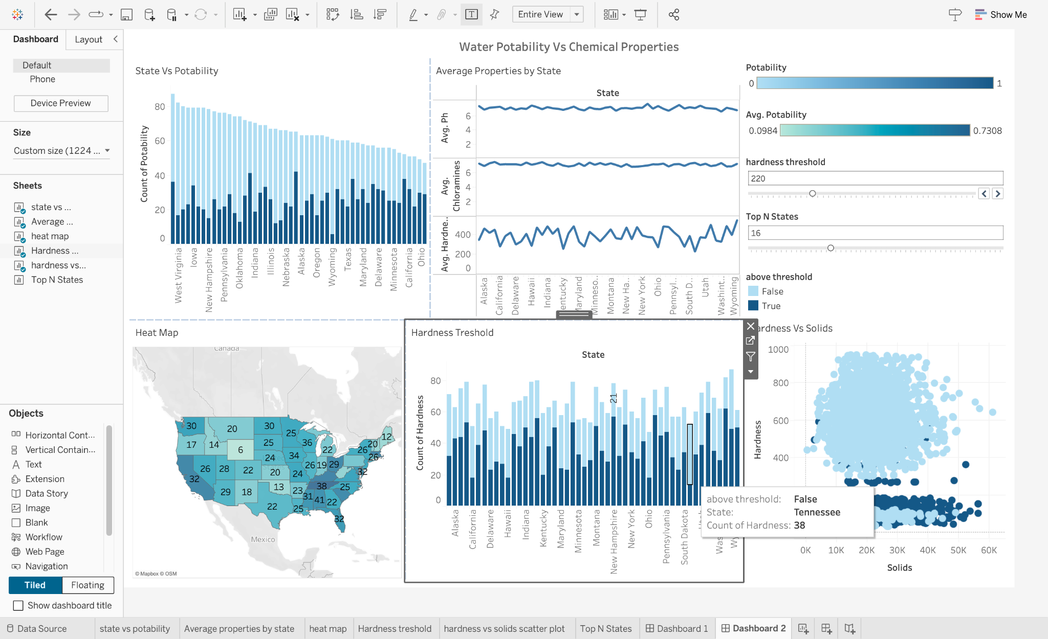
Tableau Dashboard

Slide 20
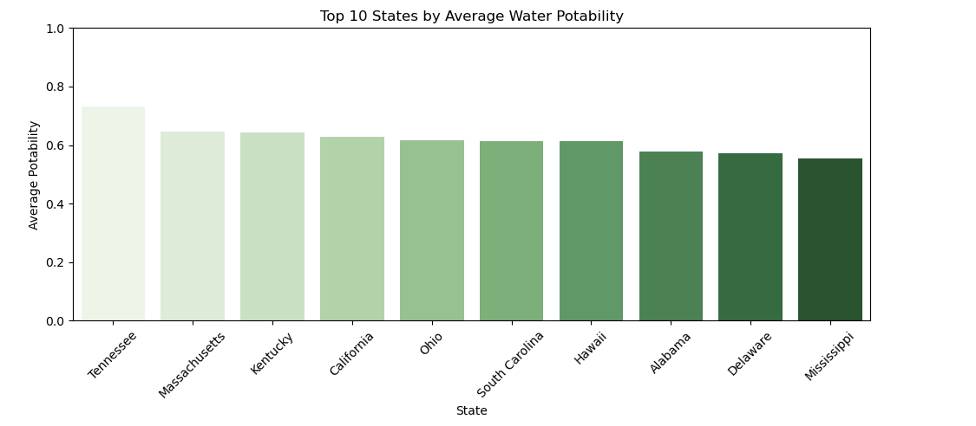
States like Tennessee and Massachusetts show the highest proportion of safe water samples.

Slide 21
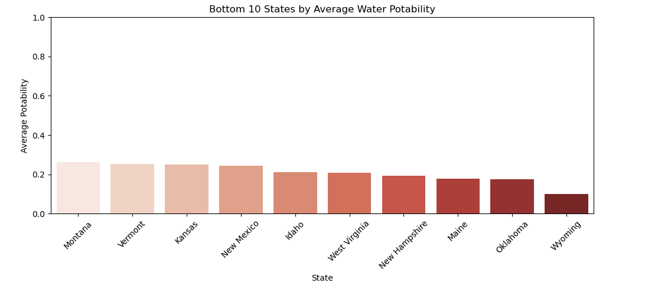
States like Wyoming and Oklahoma have the lowest average potability in our dataset.

Slide 22
Problems & Solutions
Low ANN Accuracy:
Initial model showed low performance, improved with feature scaling and architecture tuning.
Weak Feature Correlation:
Correlation matrix showed weak linear relationships; resolved using ANN.
Frontend–Backend Issue:
API response wasn’t reaching UI , fixed Flask route handling.
OpenAI API Integration:
Difficulty integrating OpenAI API with Flask , solved by switching to OpenRouter client and adding error handling.
Advancements :
Enable chatbot to generate visualizations from queries.

Slide 23
THANK YOU

